Slide 1

Where precision meets the skies

Slide 2

Drone
Track-box

Slide 3
Flight controller
RS2205 motors
ESC
Carbon-fiber frame
Futaba 7c transmitter

Slide 4
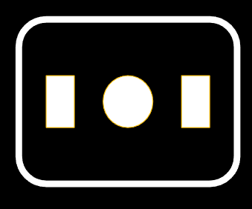
ESP32 CAM
Neo 6m GPS
Solenoid electromagnet
Single channel 5V relay
PDU

Slide 5
Why AeroGuard?

Slide 6


More than 320 people die each year in high-speed police pursuits, and 27 percent of those killed are innocent bystanders
Notes:
Statistics provided by newsweek on behalf of USPD

Slide 7

Safety
2. Cost-effective
3. Agility
4. Enhanced visibility
5. Real-time tracking
6. Improved surveillance
1.

Slide 8
AeroGallery

Slide 9
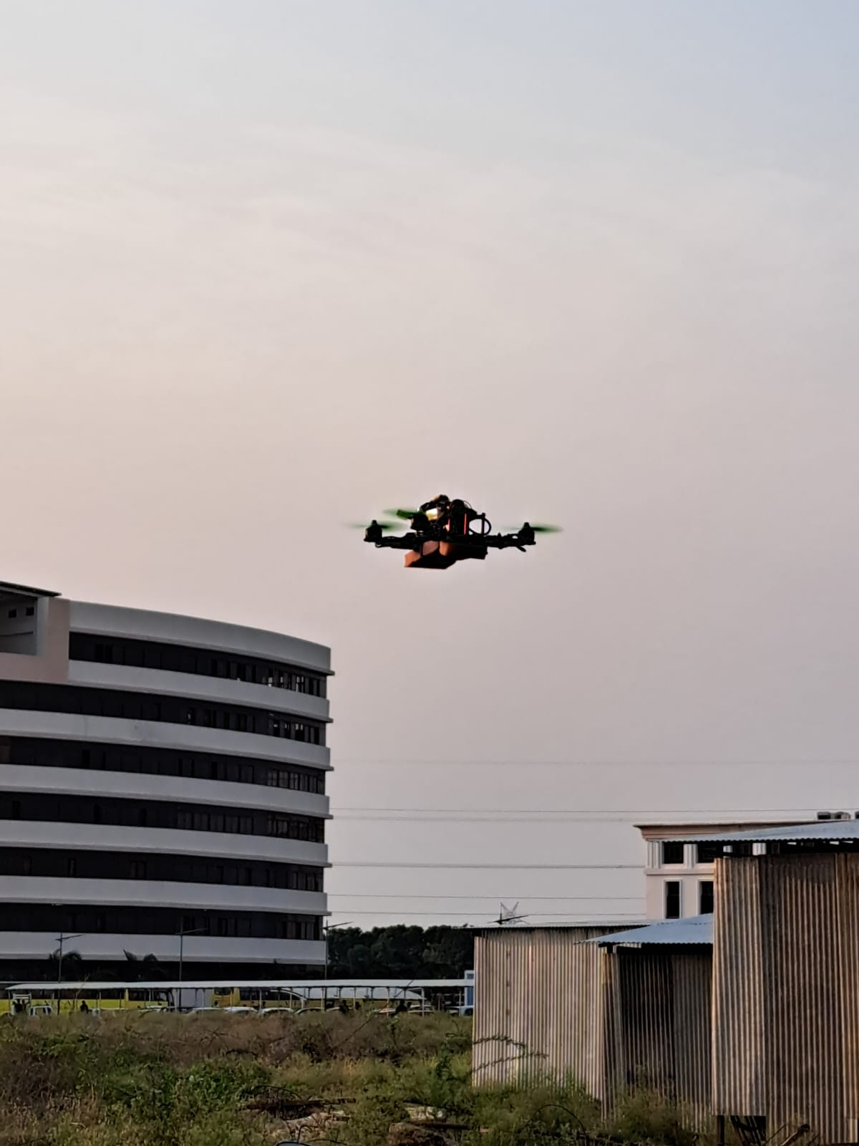

Slide 10
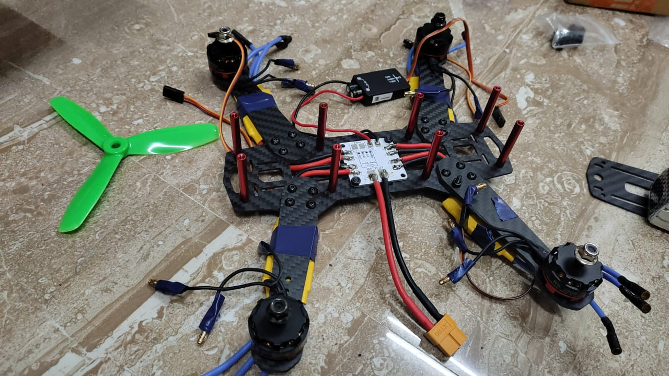
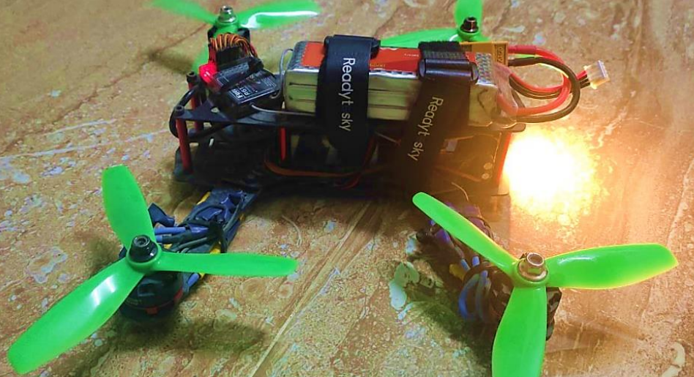

Slide 11


Slide 12
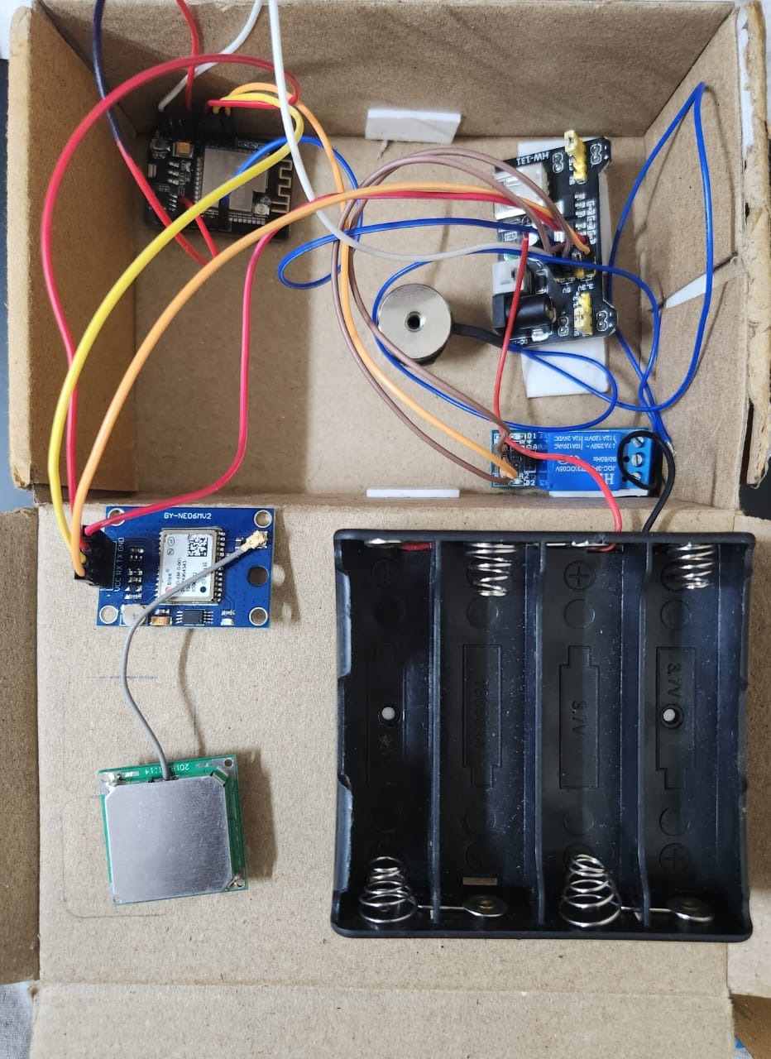
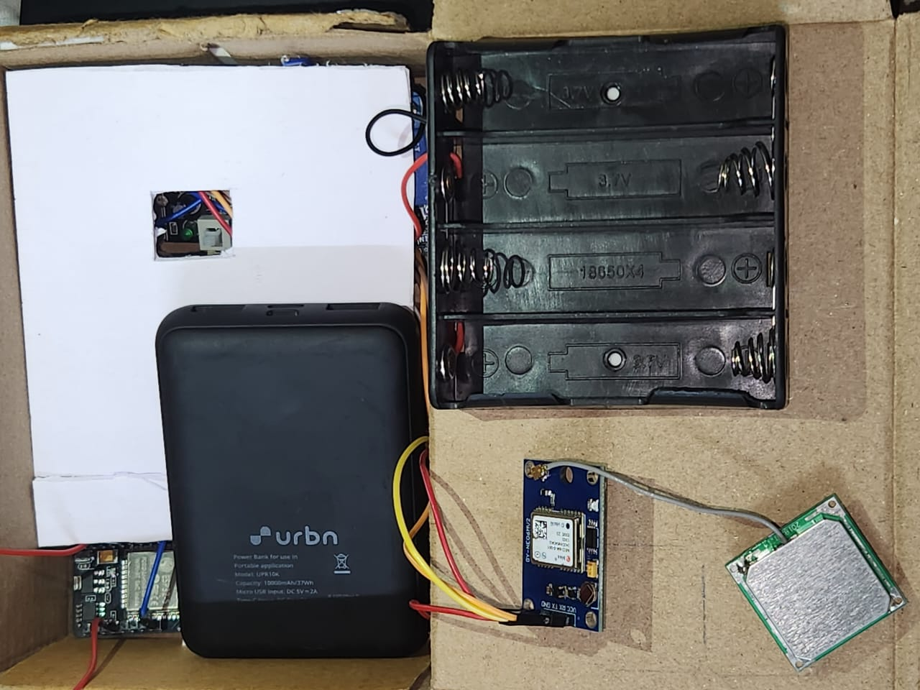

Slide 13
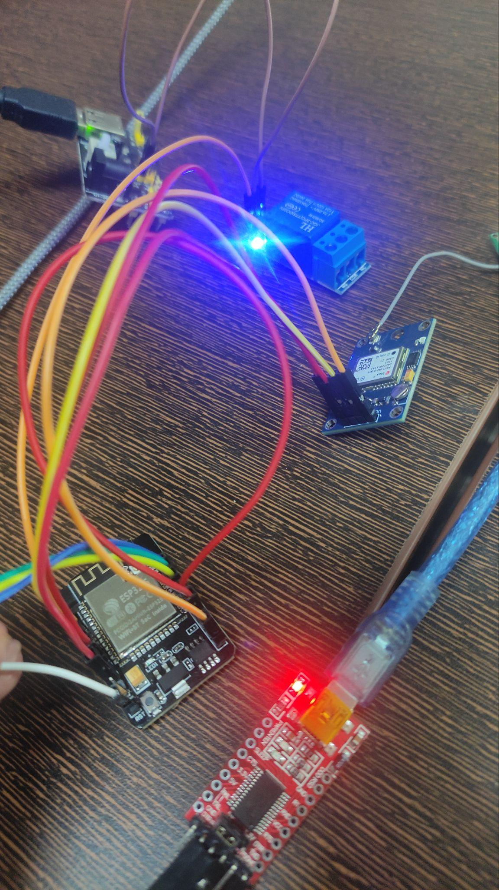
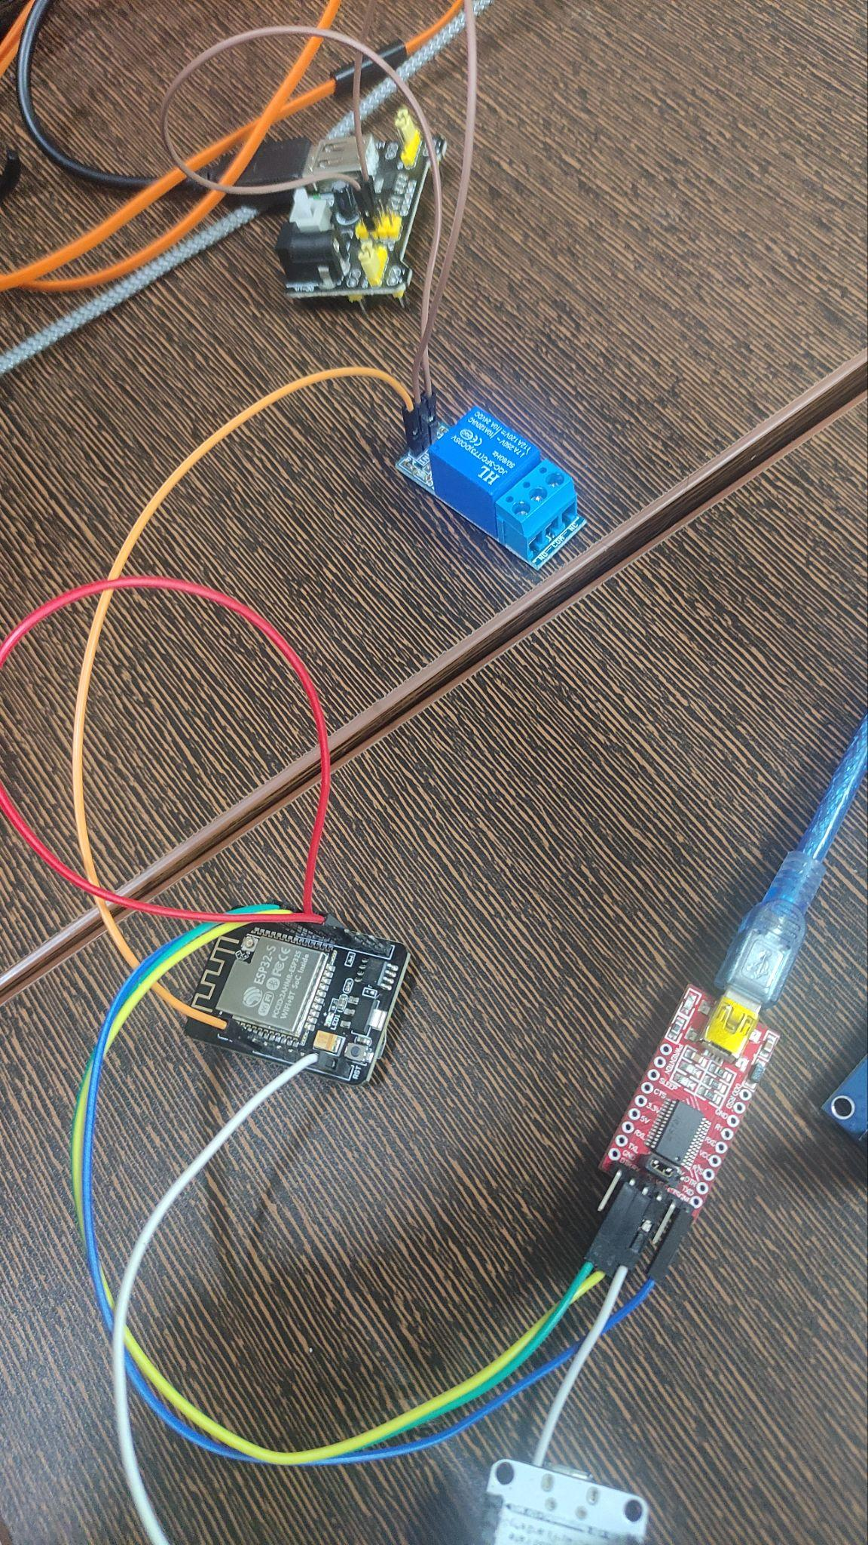

Slide 14
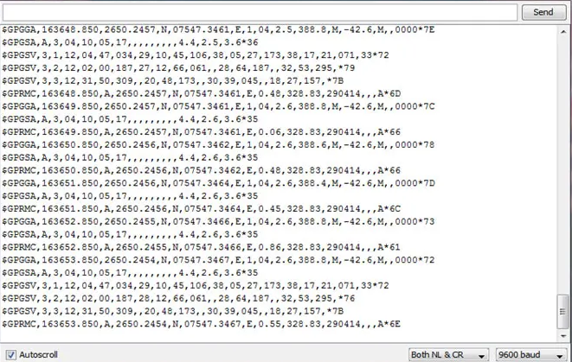

Slide 16
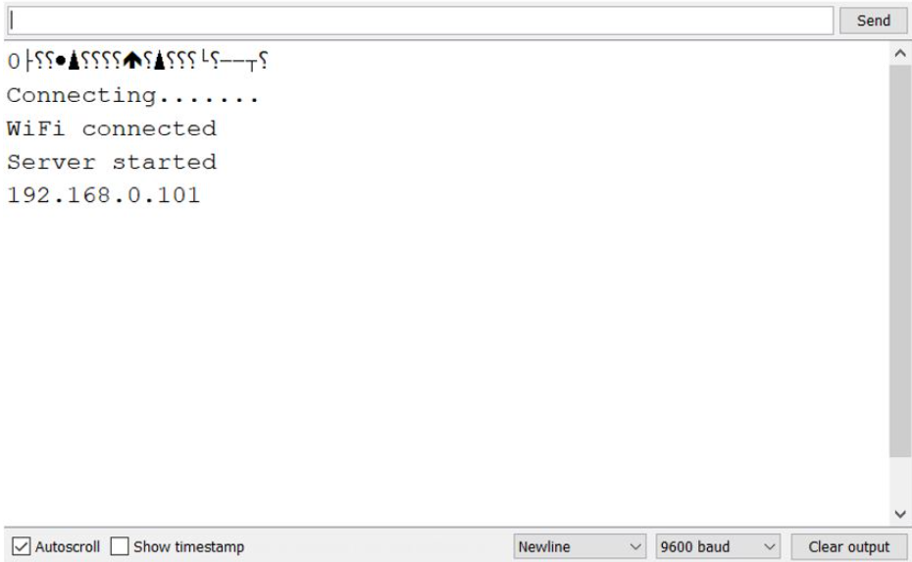
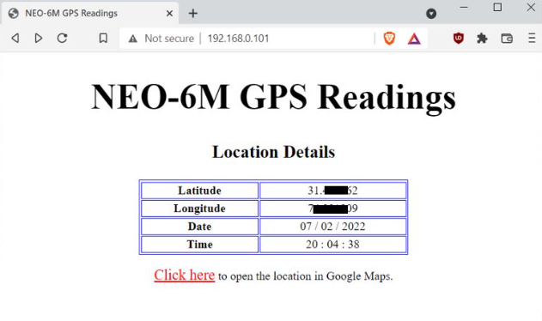
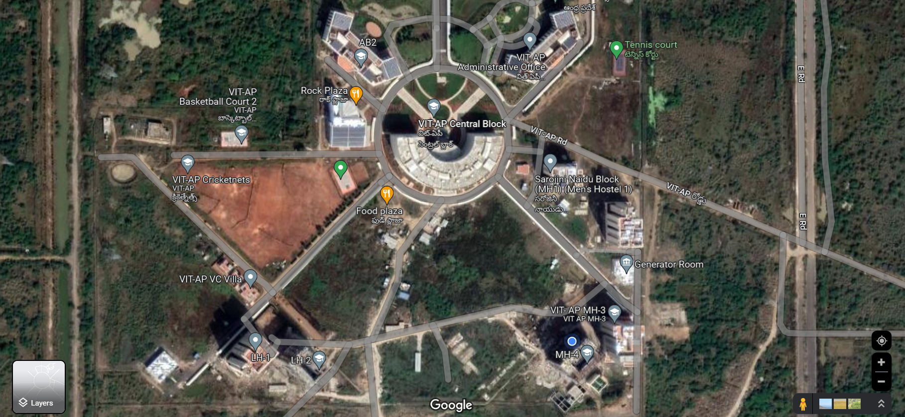

Slide 17
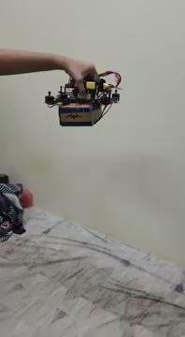

Slide 18
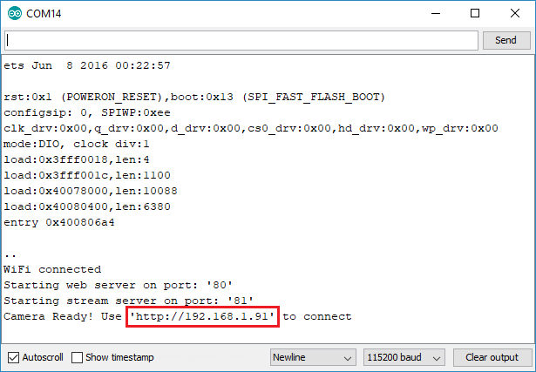

Slide 19
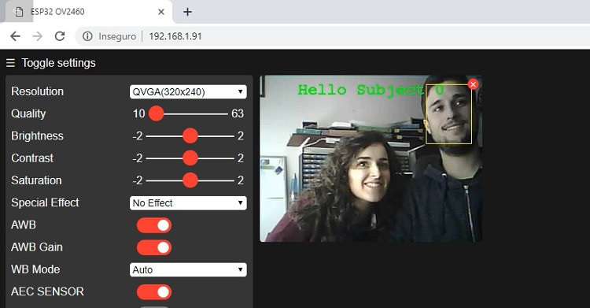


Slide 20
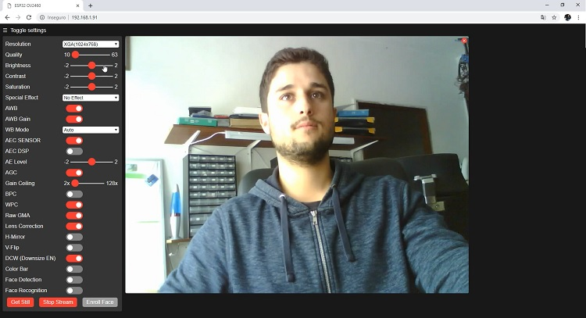
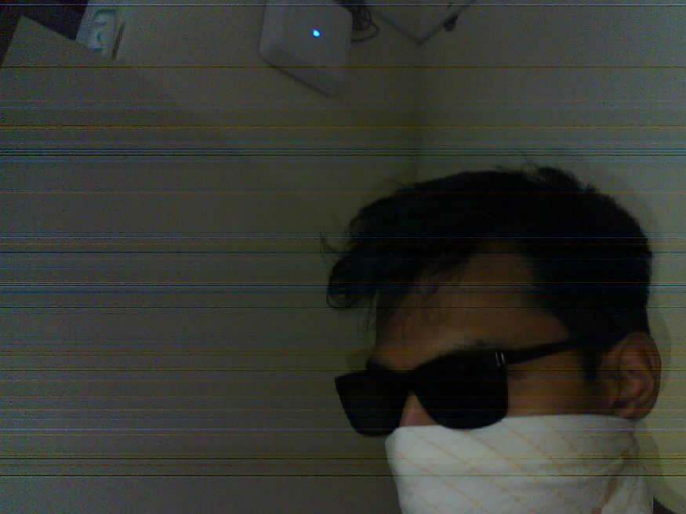

Slide 21
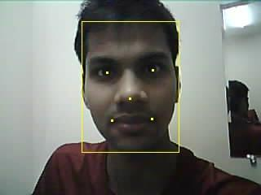

Slide 22
AeroFuture

Slide 23
Further Applications
Forest-fire detection and prevention
Real-time surveillance
Supply drop (Medications, food)
Search and rescue
Military use
Mob control

Slide 24
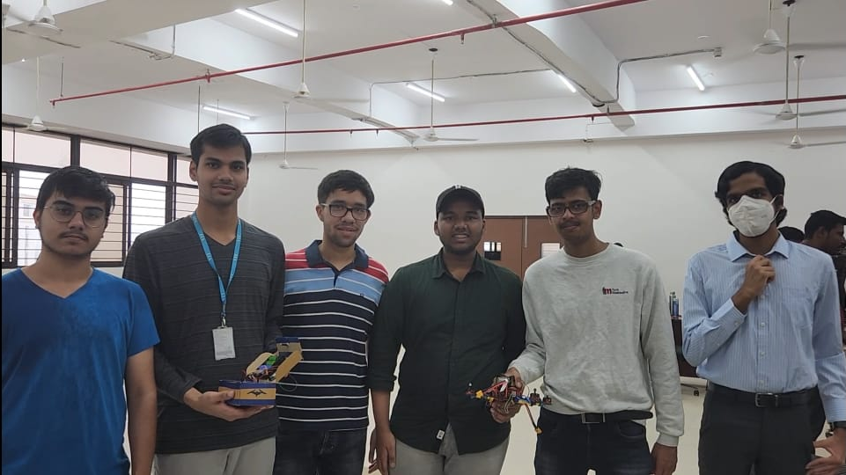
TeamAero

Slide 25


Slide 26
Source Code
Github gist link

